Slide 1

RentSmart
Automated Rental Affordability Engine for the Melbourne Market
Somesh Shanbhag
Lead Business Analyst | MetroProp

Slide 2




The Bottleneck: Manual Processing
Currently manual affordability checks are costing us valuable tenants.
Average time to process a single application is 48 Hours.
High-quality tenants lost to competitors due to wait times, approximately 15% as per lease agents.
No tool exists for tenants to instantly filter "Affordable Suburbs."

Slide 3



Methodology & Governance
Governance
Traceability
Validation
Managed via RACI Matrices & Stakeholder Mapping to ensure clear accountability.
Full requirements traceability maintained using Jira & Confluence integration.
Business logic validated via Python prototyping and SQL analysis against 20k records.

Slide 4

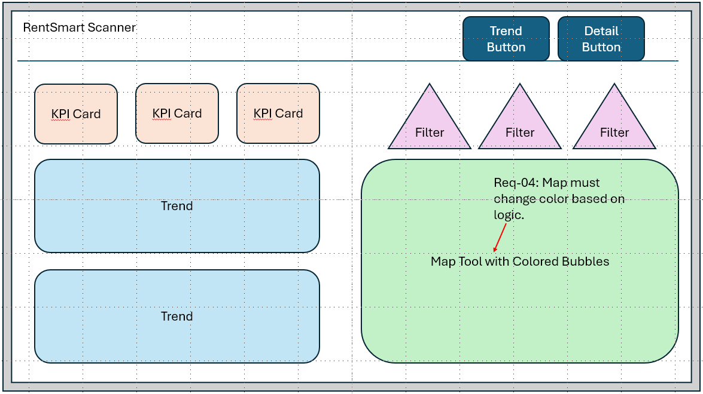


The Rentsmart Scanner
Smart Logic
Automatically flags properties where Rent < 30% of Income.
Dynamic Control
Income slider adapts instantly to each unique user
Instant Result
Decision time reduced to < 5 seconds.

Slide 5



Next Steps & Recommendation
Approve Logic: Greenlight the Python algorithm for production API integration.
Allocate Budget: Release funds for Phase 2 (Mobile App Rollout).
Launch Campaign: Target "Western Metro" regions identified as high-yield zones.

